Slide 1

COVID-19 Prediction
By Yesbol Bavarkhan BDA-1904
Mirolim Saidakhmatov BDA-1902

Slide 2
Data description
Symptoms: Breathing Problem, Fever, Dry coughbr, Sore throatbr and etc.
Contact types
Sanitary standards

Slide 3
Data preparation
Data was preprocessed
Values were replaced

Slide 4
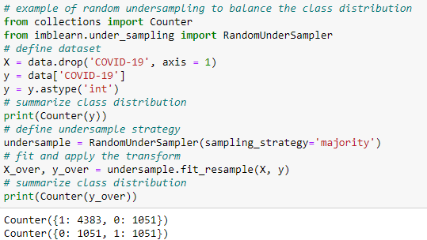
Handling imbalanced data

Slide 5
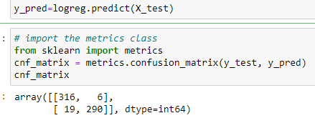
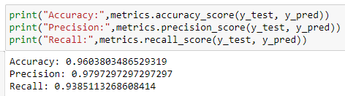
Predicting without feature selection

Slide 6
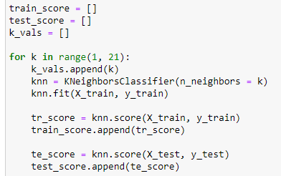

KNN

Slide 7
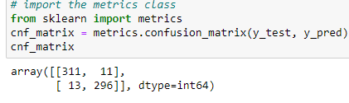
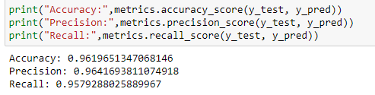
Predicting features selected

Slide 8
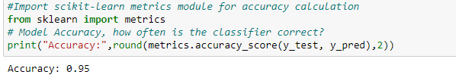
KNN with features scaled

Slide 9
Conclusion
In this work we worked with Feature selection and classification modules. After working with Feature selection, the accuracy of the classification modules decreased by 1-2%. A telegram bot was also created that will help diagnose a patient by analyzing his symptoms. With the help of the classification modules, we learned that the bot's accuracy is 96-97%. This will save you time, money, and unnecessary visits to the doctor.

